Slide 1
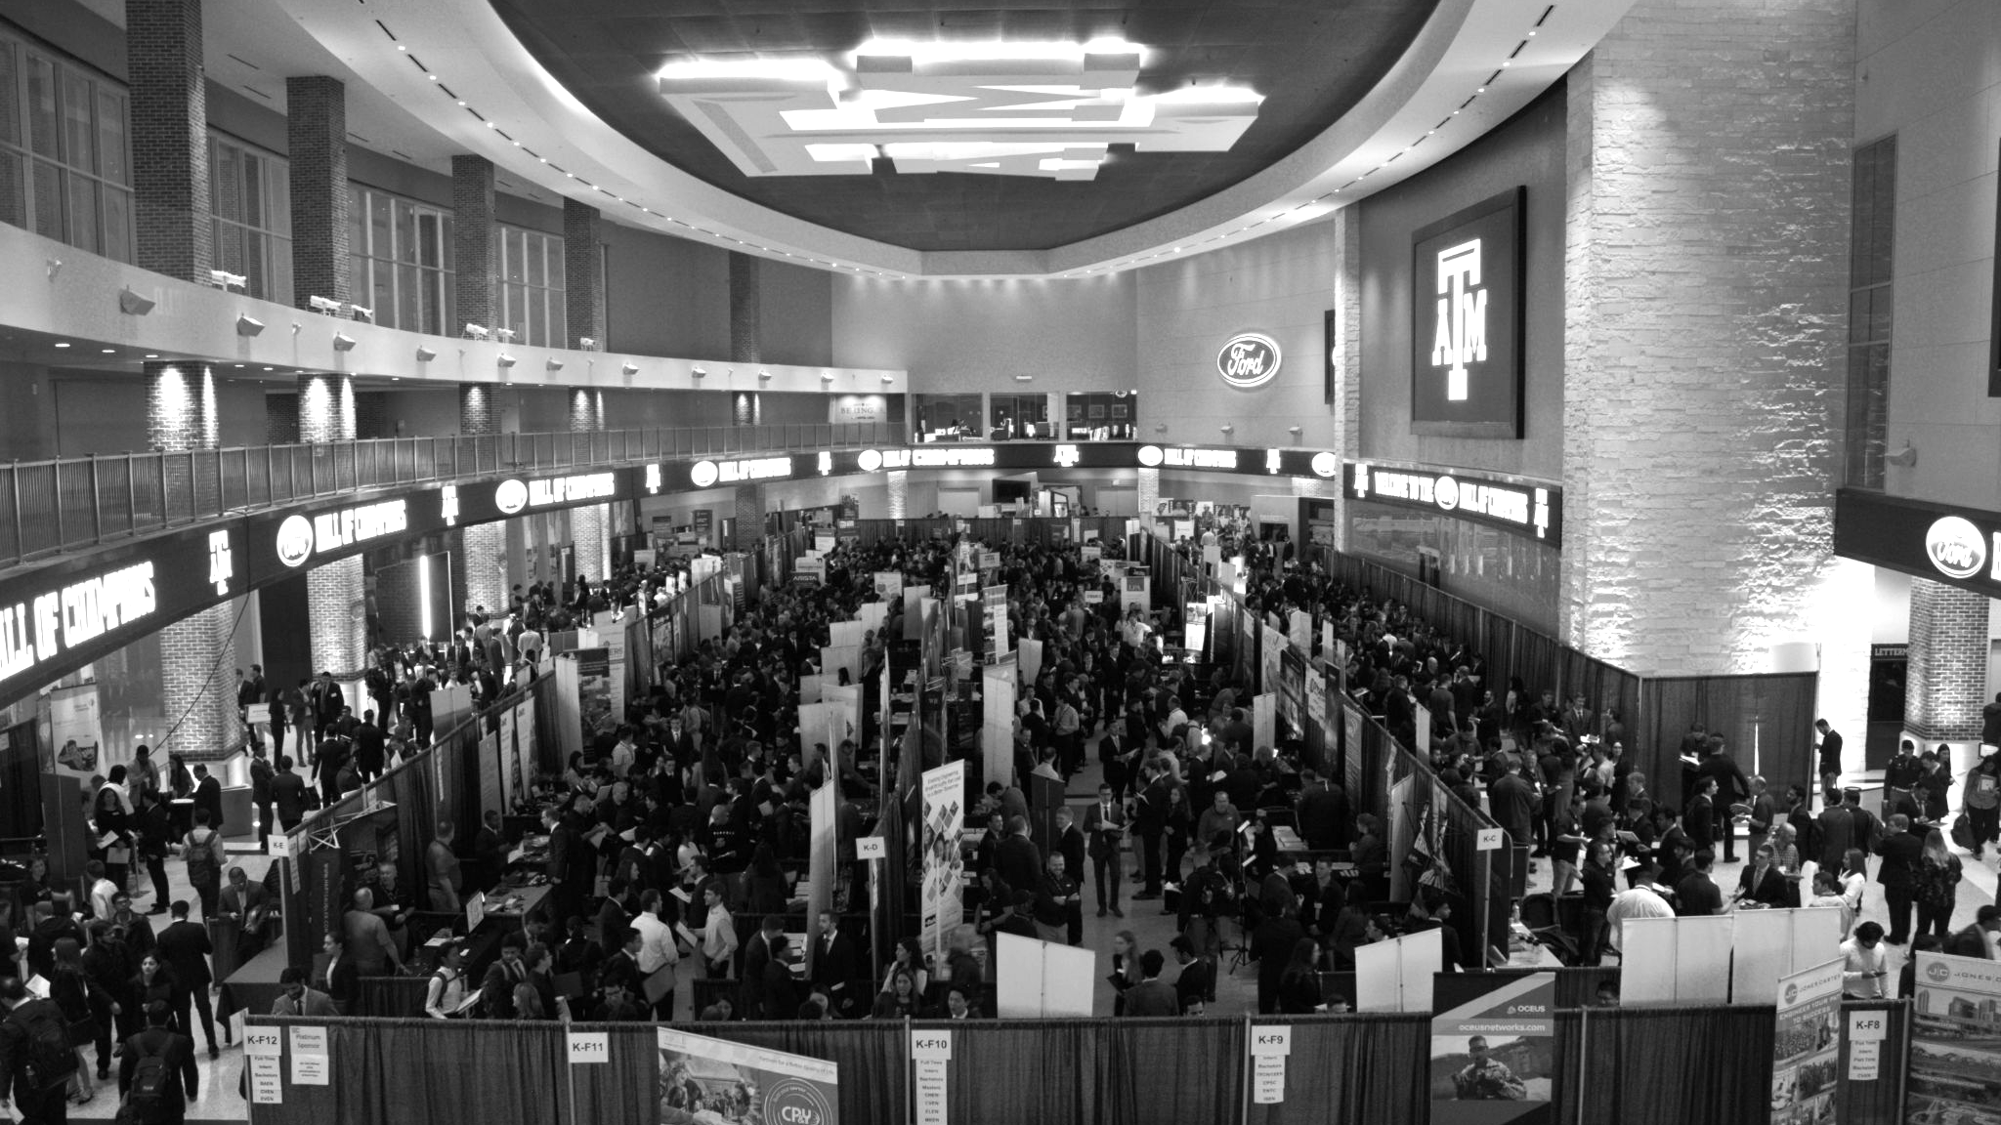

LANL Team Update
9/25/2024
Izzy Baumler, Dalton Boeckmann, Morgan Gullo, Jade Waldron

Slide 2
Mission Statement
To design and prototype a semi-autonomous robotic arm that is attached to the Boston Dynamics Spot quadruped robot that can cover a 3 foot radius area.
-cover surface area of x
-semi-autonomous
-6 DoF movement
-can handle a weight of XX at the end

Slide 3
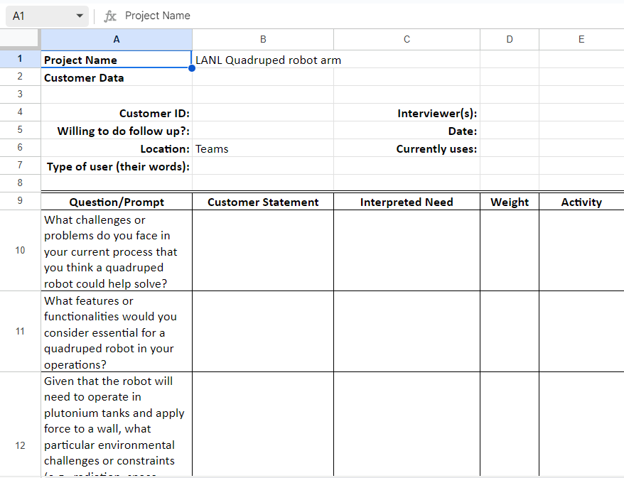
Weekly Task Updates
No meeting with sponsor last week, he is on vacation this week
We have a meeting with two “customers” (LANL employees) this Friday

Slide 4
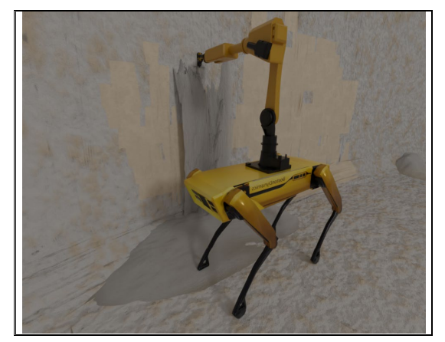
Weekly Task Updates
Tasks per person-
Dalton Boeckmann: Static Analysis, Kinematic Analysis
Izzy Baumler: Kinematic Analysis, Functional Block Modelling
Jade Waldron: Customer Needs, House of Quality, Reviewing Engineering Drawings
Morgan Gullo: Analyzing railing system (with arm, DC motor, and computer)

Slide 5
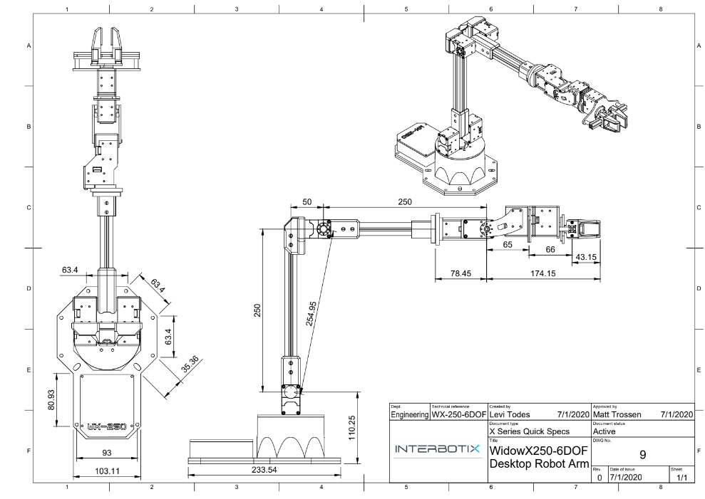
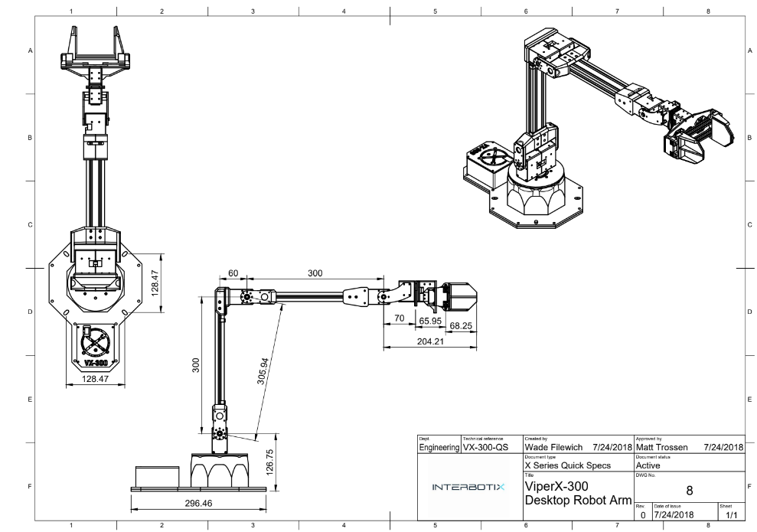
Weekly Task Updates
Mobile Aloha Arm
https://docs.google.com/document/d/1_3yhWjodSNNYlpxkRCPIlvIAaQ76Nqk2wsqhnEVM6Dc/edit#heading=h.orhhau6mjexw

Slide 6
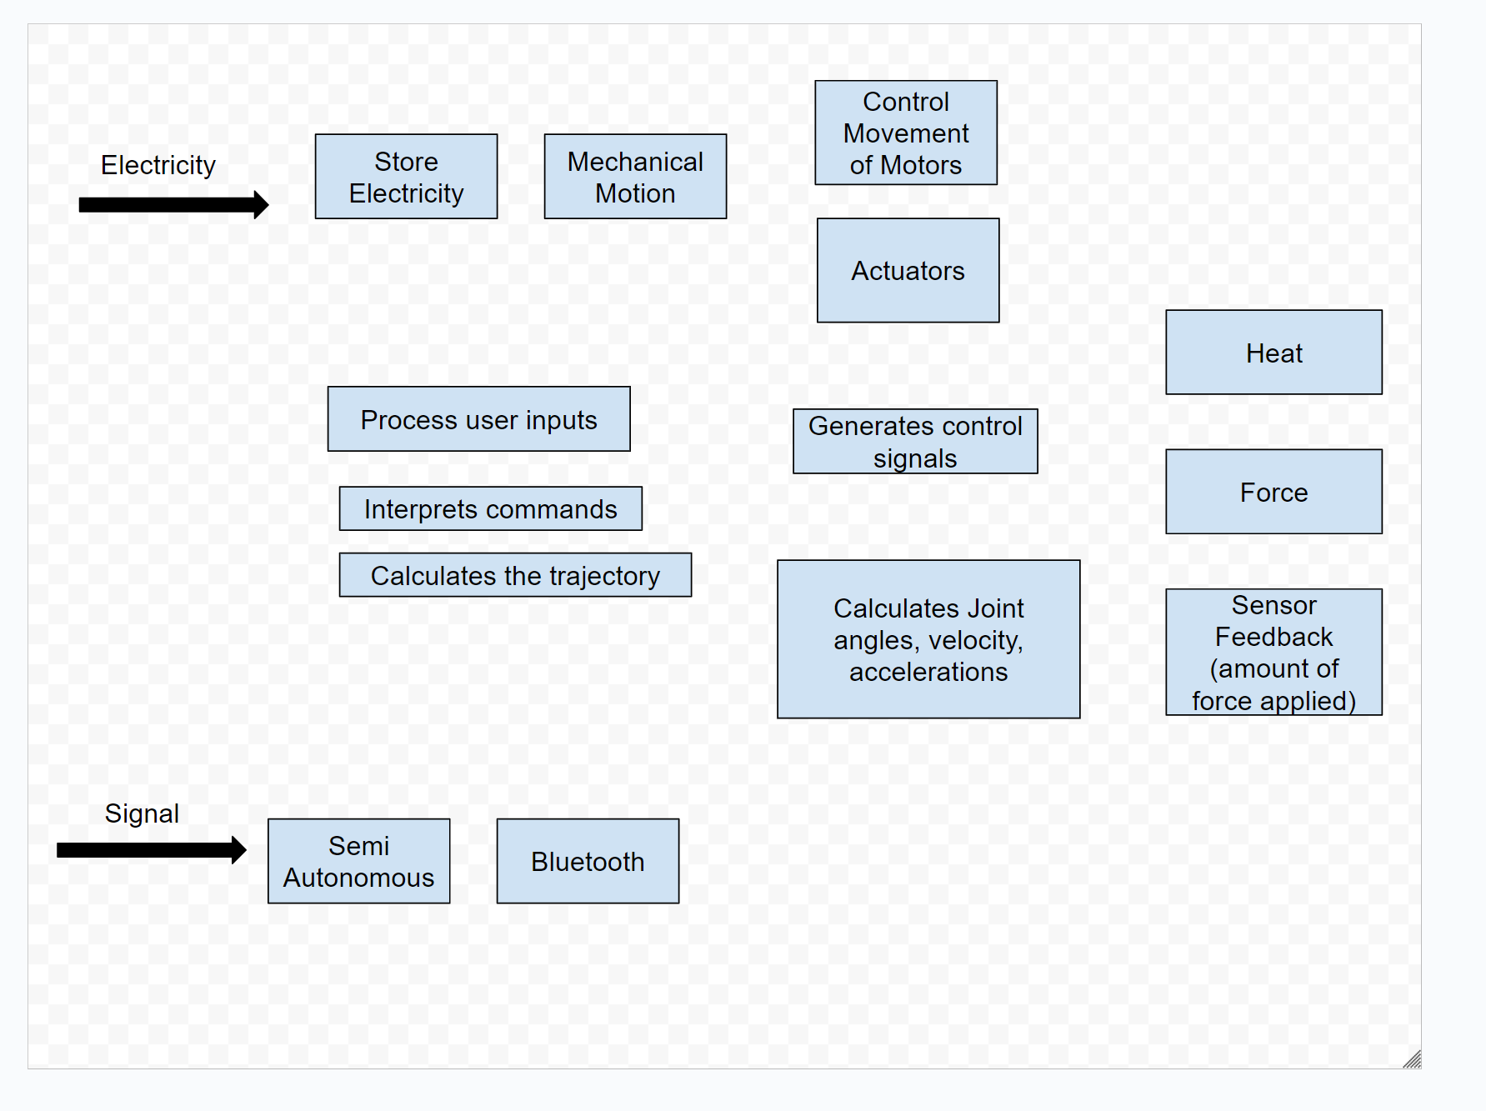
Functional Block Model Rough Draft

Slide 7
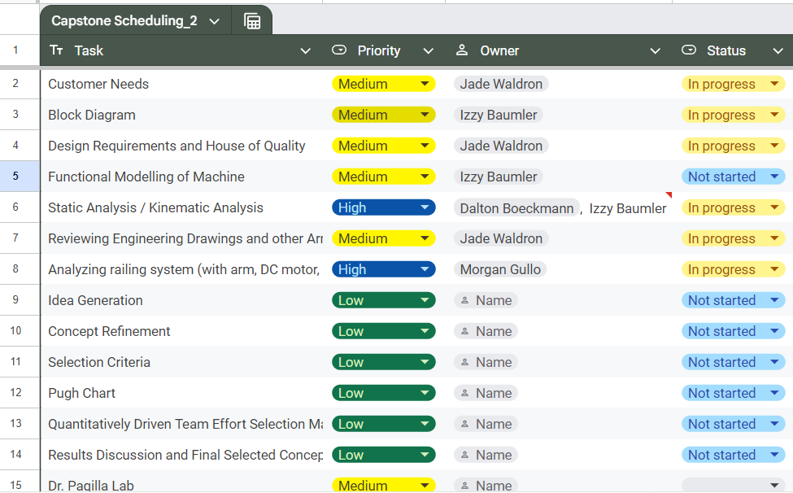
Weekly Task Updates

Slide 8
Upcoming Week
Meeting with LANL (David) next week
Finalizing Functional block model
Finishing Kinematic Analysis (Izzy and Dalton)
Finishing Customer needs for for the LANL interviews we are conducting on Friday

